Slide 1
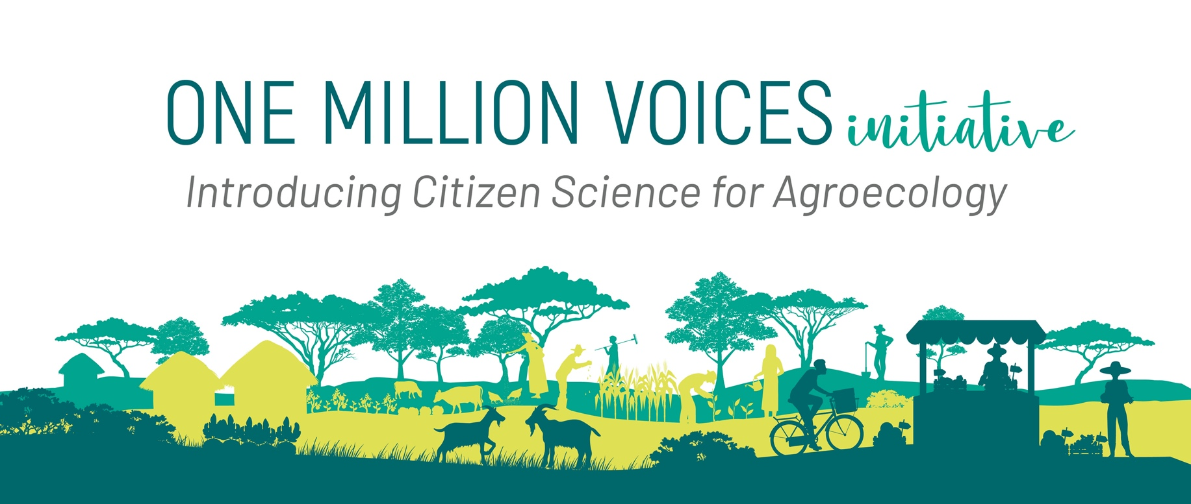
Dialogue results: Andes of Ecuador, Perú and Bolivia, South America
Sergio Larrea
February 16th, 2023
Building on existing projects and approaches to foster agroecological transitions

Slide 2
Introduction
Facilitator of the McKnight Community of Practice in the Peruvian, Bolivian and Ecuadorian Andes
Key members of the CoP an other key stakeholders in the region were consulted from September 2022 to February 2023:
Perú: National Association of Ecological Farmers (ANPE), NGO YANAPAI, CIP
Bolivia: Bolivian Agroecological Movement, NGO Agrecol, NGO PROSUCO, NGO Ciudadanía
Ecuador: Agroecological Collective, NGO SwissAid, NGO Aliados, INIAP, IRD
Colombia: UNIANDES-IRD
AES-University of Vermont working in Ecuador, Perú and Bolivia

Slide 3
Existing Citizen Science initiatives in the region
Some of the science citizen iniative contacted:
PROSUCO in Bolivia with a net of meteorological stations
YANAPAI in Peru with Varscout, Inaturalist
IRD in Ecuador with Inaturalist
Bolivian Agroecological Movement: Civil Society Observatory for food systems
Agroecomakers with IRD-CIAT-Uniandes in Colombia
All Collectives and Movements are using tools to communicate

Slide 4
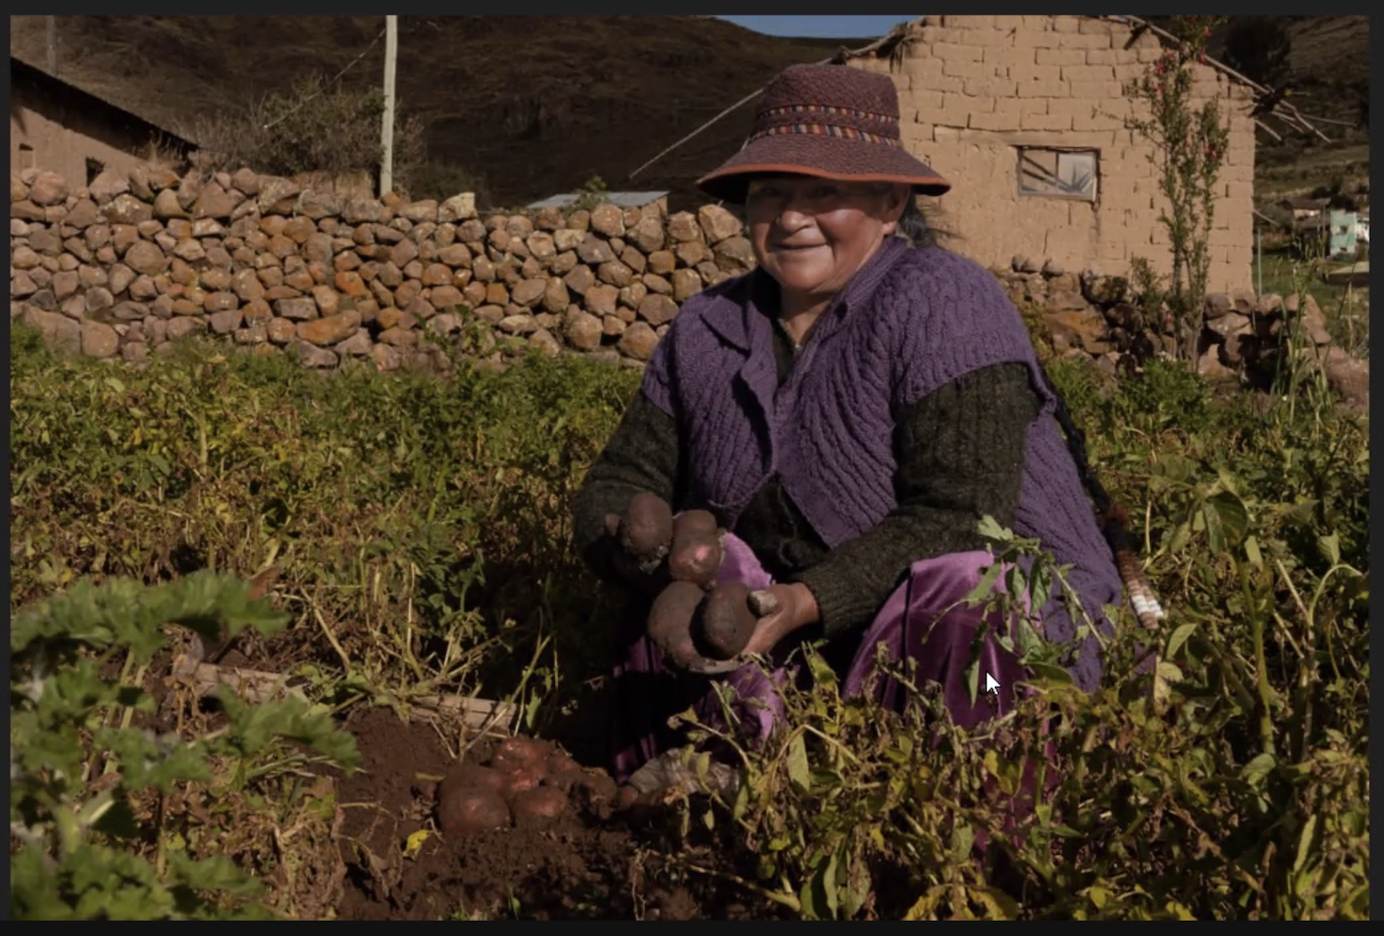
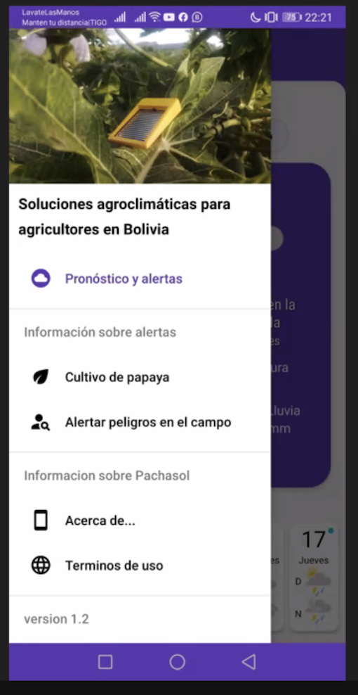
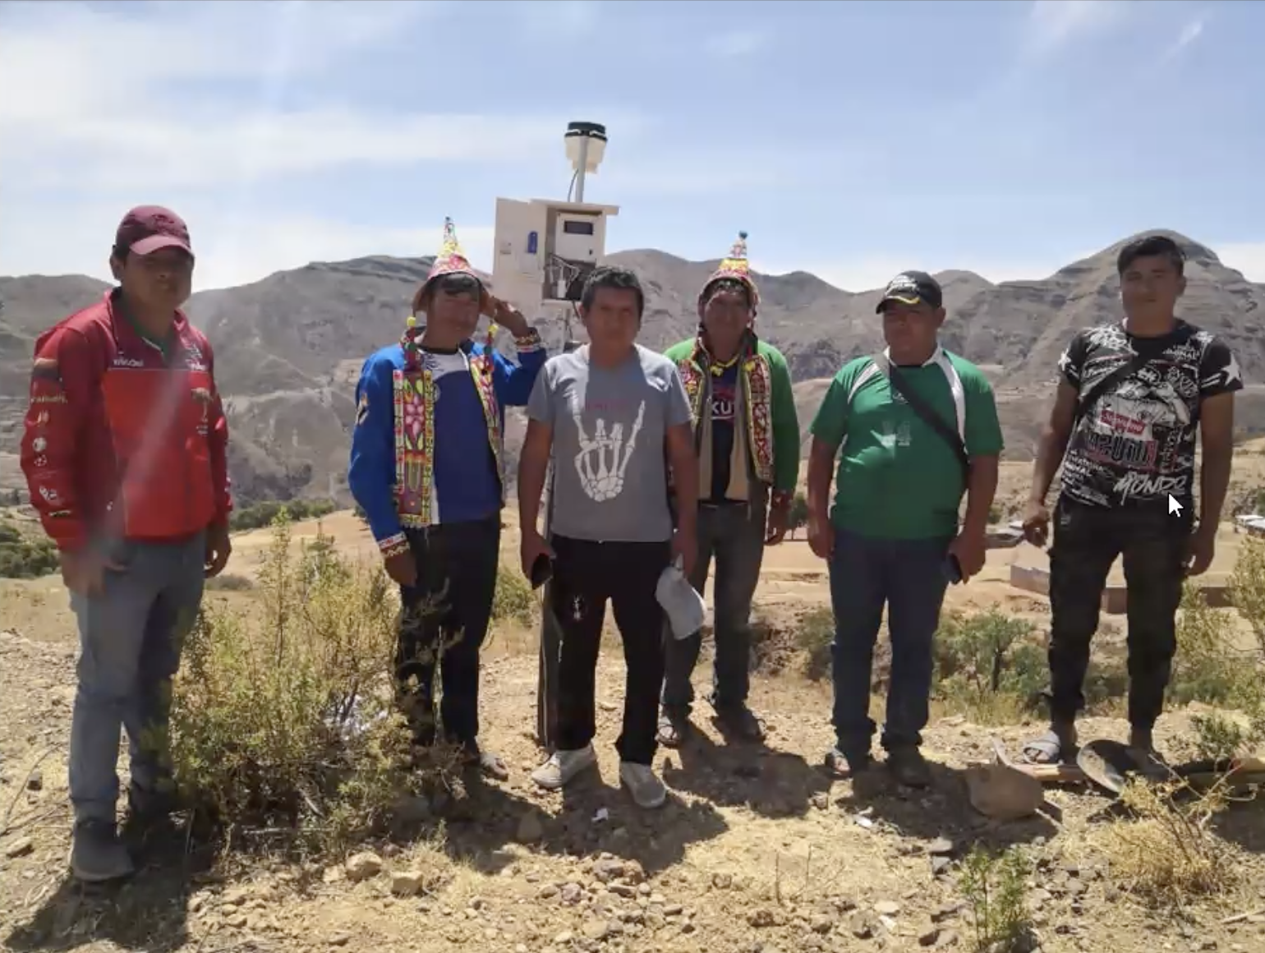
Farmer in the Bolivian Andes
Source: PROSUCO
App for agroclimatic solutions
Source: PROSUCO
Meteorological stations in the Bolivian Andes
Source: PROSUCO

Slide 5
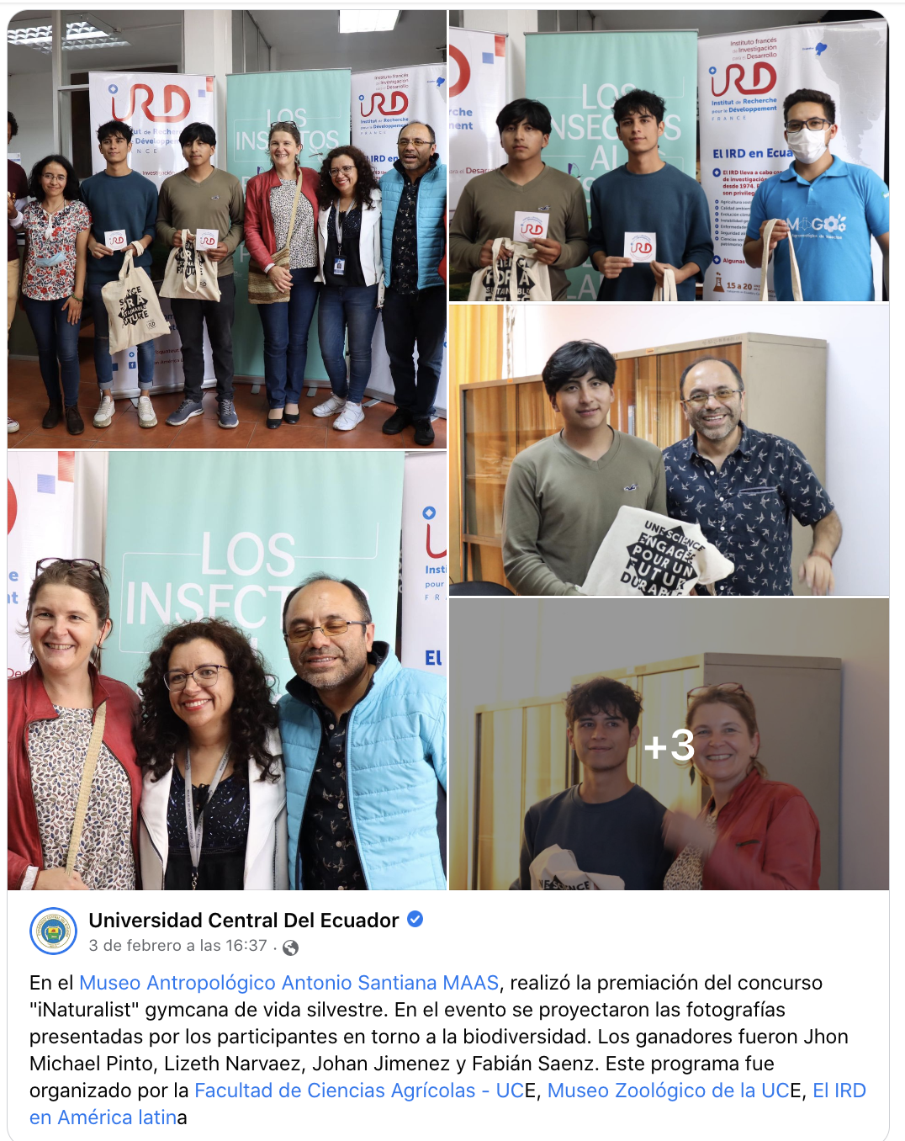
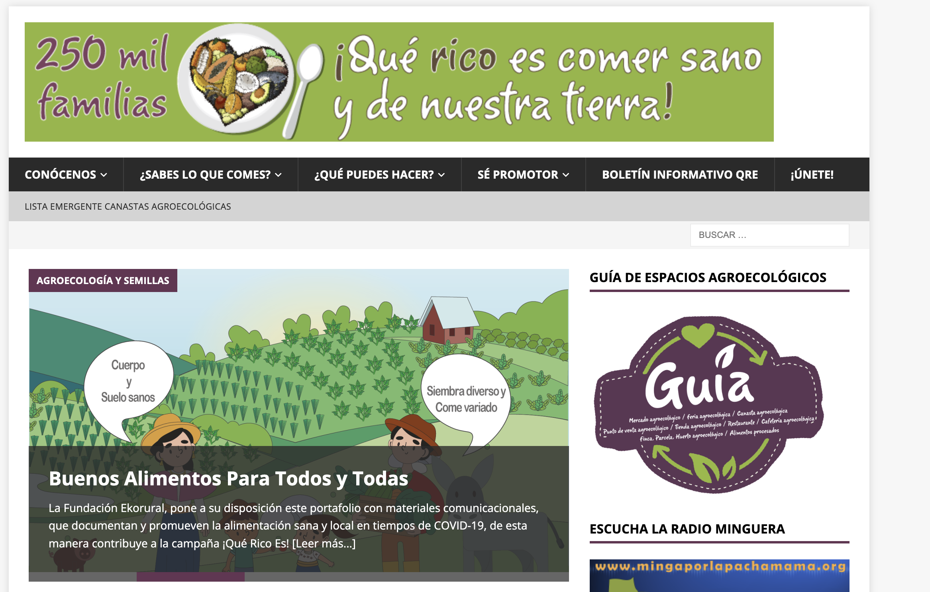
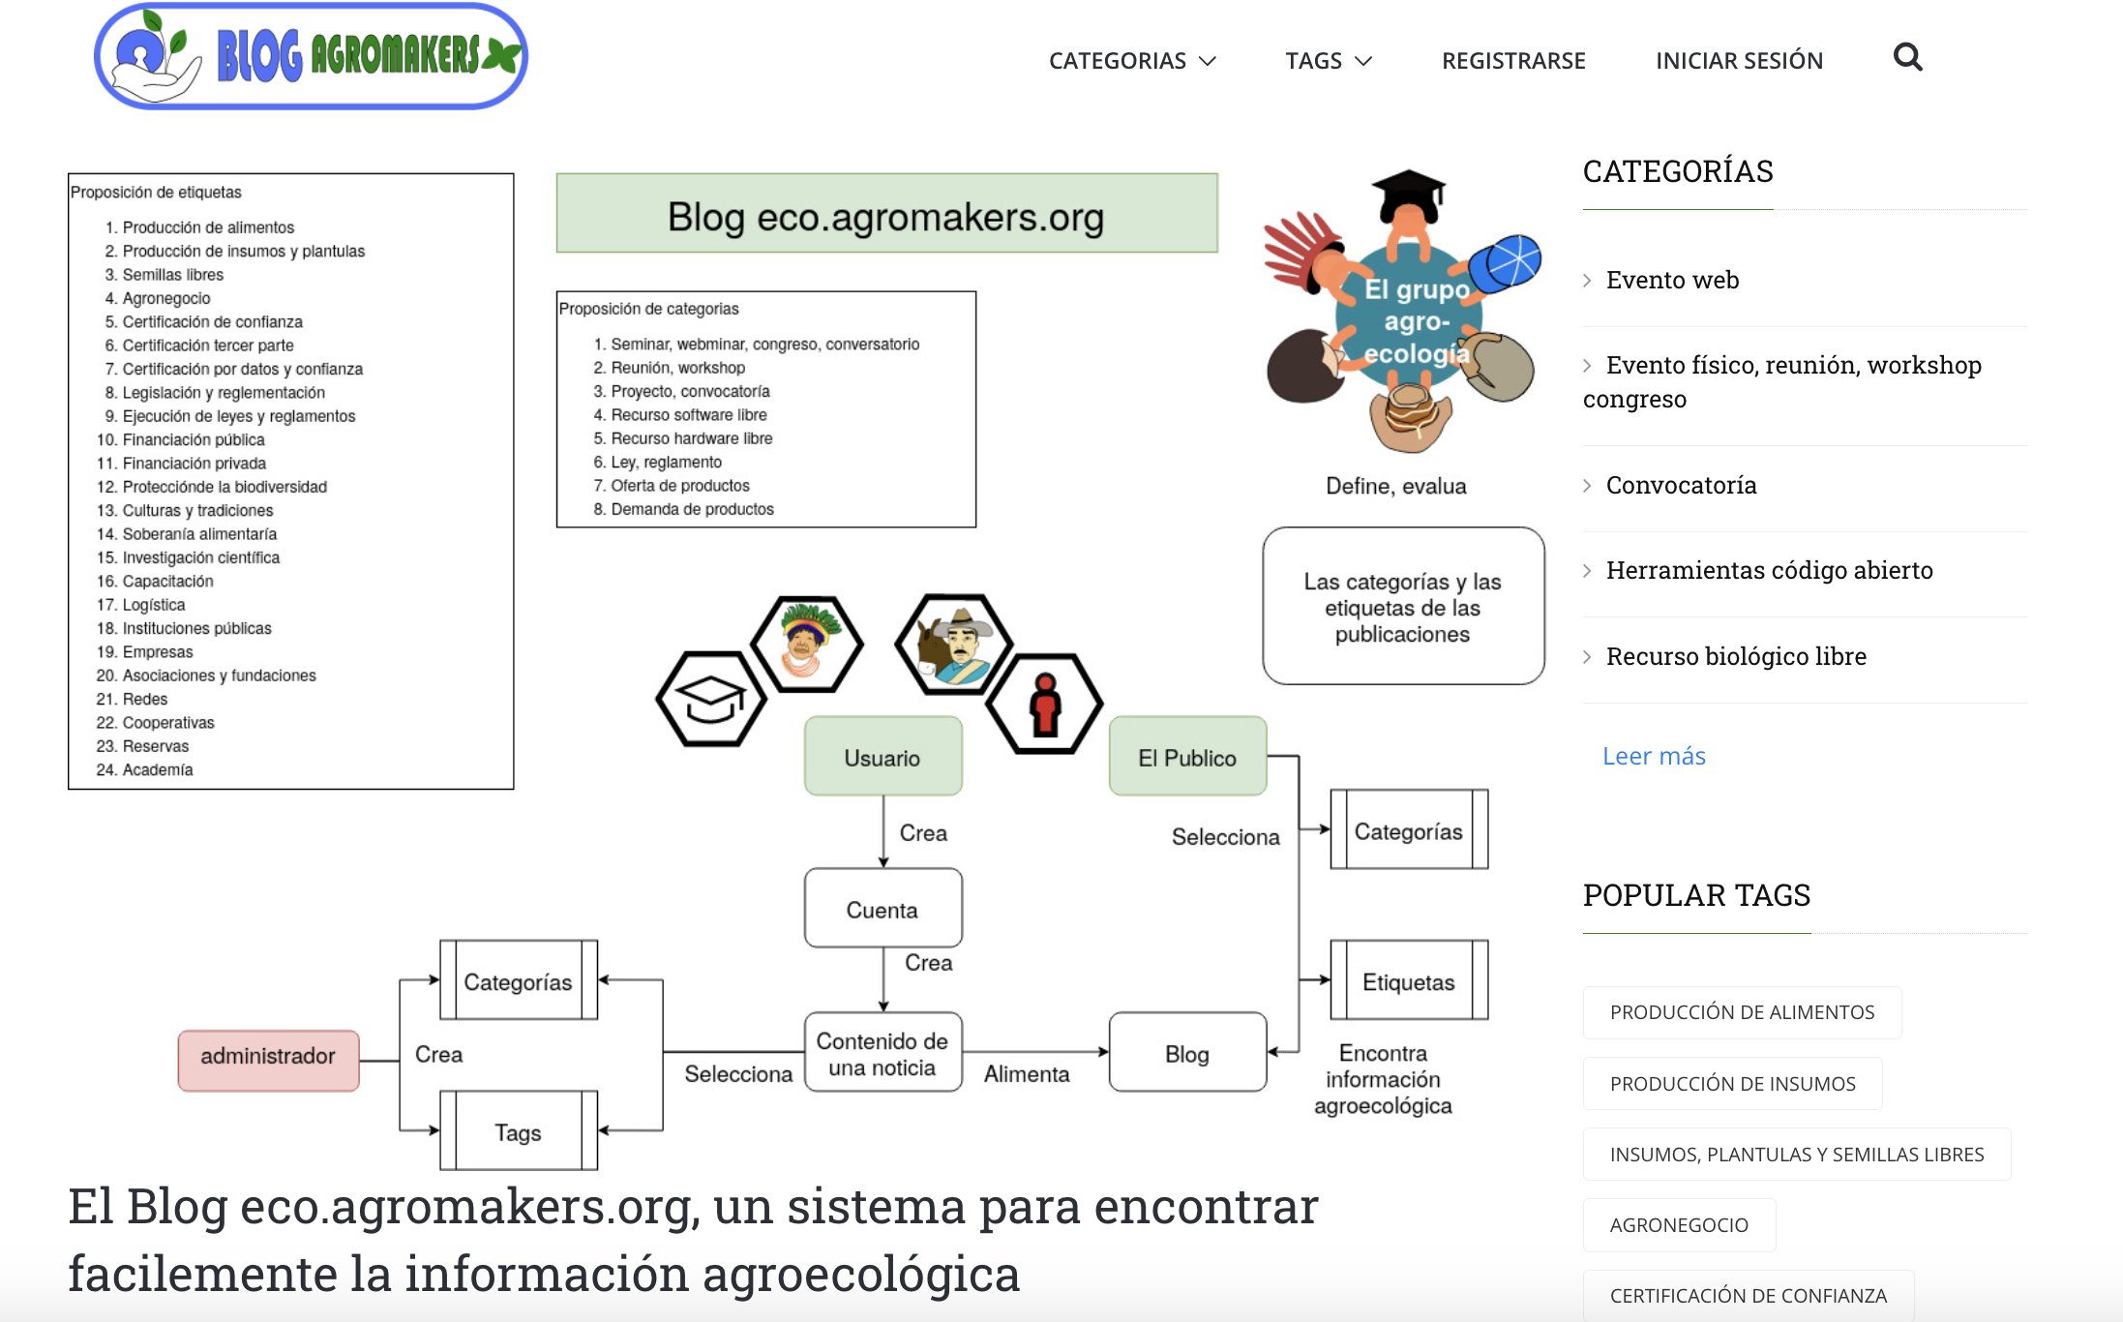
Source: Colectivo de Agroecología, Ecuador
Implementing Inaturalist in Ecuador
Source: Diego Mina, IRD
Source: Agromakers

Slide 6
Proposed research questions for new global CS initiative
Connecting experiences, evidence and research initiatives
How to generate interactions and collaborations among multiple actors to promote agroecology?
How to take advantage of the different knowledge and experiences in agroecology to strengthen movements?
Challenges:
Multiple understandings of agroecology transitions.
Complexity and contradictions within agroecological movements
Balance between science and other forms of people's knowledge
Facilitation is necessary
The tension of a local need vs. an understanding of the global
Respecting local processes

Slide 7
Proposed research questions for new global CS initiative
Generation of knowledge
Generation of information on agroecological production for supply
Generation of climatic information for decision making (Climate change)
Linking consumers and producers (markets, food systems).
Some challenges:
Sustainability of the initiative
Information useful and adapted to the context
Balance between science and other forms of people's knowledge

Slide 8
Dialogue results: Contents, modes of engagement, nature
Possible contents
For movements and collectives: Connect experiences, evidence and research initiatives.
For producers and consumers: information for decision making: climate, markets, etc.

Slide 9
Dialogue results: Contents, modes of engagement, nature
Possible contents:
For movements and collectives: Connecting experiences, evidence and research initiatives.
For producers and consumers: information for decision making: production, climate, markets, etc.
Opportunities and modes of engagement:
Youth as a bridge between urban and rural, between adults and new generations.
Respect for local processes and organizational processes
Support existing small initiatives: PROSUCO, YANAPAI through Farmer Research Network, for example
Colectivo de Agroecología in Ecuador: 250.000 families iniciative
Bolivian Agroecological Movement

Slide 10
Scaling plans: How we will gather One Million + voices
Consultations in the Andes (from september 2022 to february 2023)
Identify major initiatives with the One Million Voices team
Hold a virtual meeting with all stakeholders to concrete collaborations in the Andes.
Pilots in some relevant locations in the Andes

Slide 11
Thank you!

Slide 12
Proposed outline (adapt as relevant)
1] Brief introduction to how, with whom, and why dialogues were held
2] What experiences with CS exist in your region – and where are likely gaps
3] Which research question might be of interest in the context of agroecological transitions (specifically knowledge and implementation gaps) for our new global CS initiative
4] What are the dialogue results about desired contents, modes of engagement (technologies), and nature for our new global CS initiative
5] Which plans do you have for scaling – or an answer to the question: How will we gather One Million Voices + through our new global CS initiative

